Slide 1

DATA SCIENCE Financial Risk Detection (Classification)
HUDSON SYLVESTOR A
(Biomedical Engineering)

Slide 2
Nutshell
Using Pandas, we import the file(excel) and perform required preprocessing of data
Data Transformation and required feature engineering is performed for valid dataset for training and testing
Plotly is used for extensive data visualization
And to find correlation between features.
With an appropriate ML Algorithm model is built and tuned. Model is trained and tested

Slide 3
Python IDE
Integrated Development and Learning Environment
that comes bundled with any Python installation and gives you an interactive interpreter experience.
It allows you to edit, run, and debug Python code in a simple Python shell and code editor environment, making it great for beginners
Visual Studio
– Virtual environment for coding

Slide 4
Packages required:
import numpy as np
import pandas as pd
import seaborn as sns
from sklearn.model_selection import train_test_split
from sklearn.ensemble import RandomForestClassifier
from sklearn.ensemble import AdaBoostClassifier
from sklearn.tree import DecisionTreeClassifier
from sklearn.linear_model import LogisticRegression
from sklearn.neighbors import KNeighborsClassifier
from sklearn import tree
import matplotlib.pyplot as plt
from sklearn.metrics import accuracy_score,precision_score,recall_score,f1_score
from sklearn.preprocessing import OnehotEncoder
from sklearn.preprocessing import StandardScaler
from imblearn.over_sampling import SMOTE

Slide 5
Major steps
Handle Missing Values
Feature Engineering
Encode categorical variables using suitable techniques. Onehot Encoding
Exploratory Data Analysis
Model training
Oversampling/Scaling
Choose regression models suitable for predicting continuous values
Model Evaluation – RandomForest
Fine-tune Hyperparameters

Slide 6
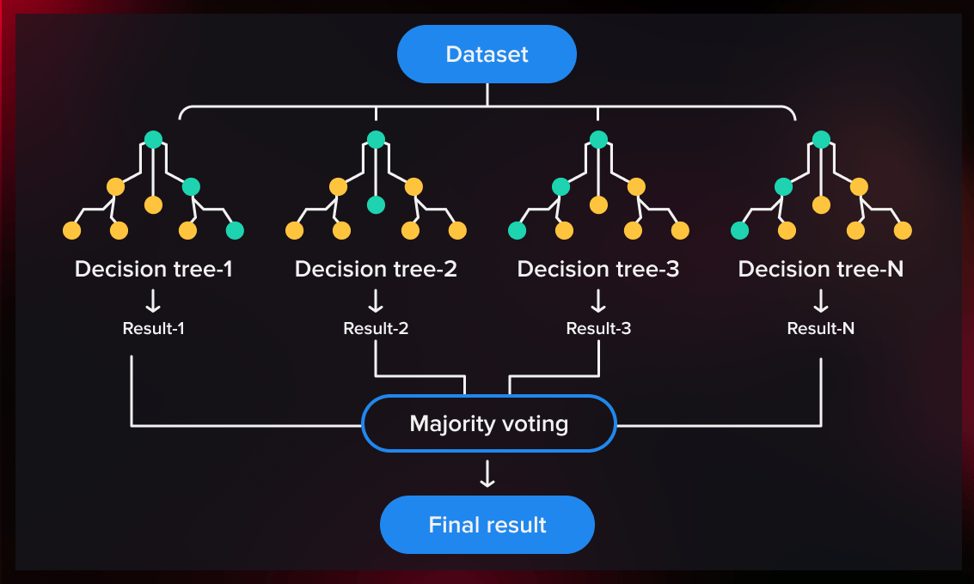
Random Forest
A random forest is a meta estimator that fits a number of decision tree regressors on various sub-samples of the dataset and uses averaging to improve the predictive accuracy and control over-fitting. Trees in the forest use the best split strategy, i.e. equivalent to passing splitter="best" to the underlying DecisionTreeRegressor. The sub-sample size is controlled with the max_samples parameter if bootstrap=True (default), otherwise the whole dataset is used to build each tree.
For a comparison between tree-based ensemble models see the example Comparing Random Forests and Histogram Gradient Boosting models.
Parameters: n_estimators int, default=100
The number of trees in the forest.

Slide 7
Lets jumppp into the project

Slide 8
THANKS
Do you have any questions?
31sylvestor01@gmail.com
759827613

